Slide 1

Statistical & Machine Learning Final Project
Adelle Price
MATH 6388, Statistical & Machine Learning
December 12, 2022

Slide 2
Credit Card Data: Classification
Goal: Classify as transactions as fraudulent/not fraudulent
Data
284,807 observations, 492 frauds
Methods
Imputation w/ SMOTE
Logistic Regression
Evaluation Metrics
- Precision, Recall, F1 Score, Accuracy
Variables
28 PCs
Time between transactions
(1st model set only)
Amount
Class
- Fraudulent/Not Fraudulent

Slide 3
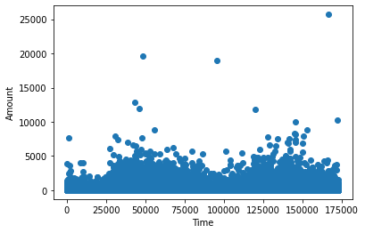
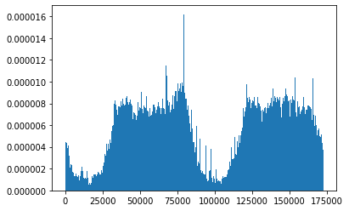
Data Exploration
Time vs. Amount
Distribution of Time variable
Notes:
Orient to plot first

Slide 4
Synthetic Minority Oversampling Technique (SMOTE)
Data before SMOTE
Data after SMOTE
Fraudulent | Not Fraudulent
492 | 284315
Fraudulent | Not Fraudulent
284315 | 284315
Total Count = 284,807
Total Count = 568,630
Notes:
Orient to plot first

Slide 5




Evaluation Metrics
Precision
Recall
F1 Score
Accuracy
Proportion of true frauds that were classified as frauds
Takes into account false pos & false negatives
Correct predictions/total predictions
Proportion of labeled frauds that are actually frauds
*Prefer this to be high*
If low, company wastes time investing false frauds
Ensure model captures true frauds
Notes:
Orient to plot first

Slide 6
Logistic Regression
Predictors: 28 PCs, Amount, Time
Before SMOTE
After SMOTE
Fraudulent | Not Fraudulent
492 | 284315
Fraudulent | Not Fraudulent
284315 | 284315
80/20 Train test split
100 resamples of test data
80/20 Train test split
100 resamples of test data
Mean Precision | 0.85
Mean Recall | 0.64
Mean F1 Score | 0.73
Mean Accuracy | 0.999
Mean Precision | 0.98
Mean Recall | 0.96
Mean F1 Score | 0.97
Mean Accuracy | 0.97
Notes:
Orient to plot first

Slide 7
Logistic Regression
Predictors: 28 PCs, Amount
Before SMOTE
After SMOTE
Fraudulent | Not Fraudulent
492 | 284315
Fraudulent | Not Fraudulent
284315 | 284315
80/20 Train test split
100 resamples of test data
80/20 Train test split
100 resamples of test data
Mean Precision | 0.88
Mean Recall | 0.63
Mean F1 Score | 0.74
Mean Accuracy | 0.999
Mean Precision | 0.98
Mean Recall | 0.94
Mean F1 Score | 0.95
Mean Accuracy | 0.95
Notes:
Orient to plot first

Slide 8
Model with Best Performance
With Time; After SMOTE
Without Time, After SMOTE
Mean Precision | 0.98
Mean Recall | 0.96
Mean F1 Score | 0.97
Mean Accuracy | 0.97
Mean Precision | 0.98
Mean Recall | 0.94
Mean F1 Score | 0.95
Mean Accuracy | 0.95
Notes:
Orient to plot first

Slide 9
Energy Efficiency Analysis
Goal: Predict heating and cooling load requirements of building
Data
768 observations
Methods
Dimension Reduction (PCA)
Linear Regression
Polynomial Regression
8 Possible Regressors
- Relative Compactness, Surface Area, Wall Area,
Roof Area, Overall Height, Orientation, Glazing Area, Glazing Area Distribution
2 Response Variables (Separate Models)
- Heating Load, Cooling Load
Notes:
Orient to plot first

Slide 10
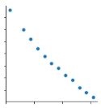
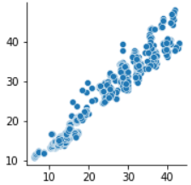

Data Exploration
High correlation between regressors
High correlation between predictors
Relative Compactness
Cooling Load
Surface Area
Heating Load
Notes:
Orient to plot first

Slide 11
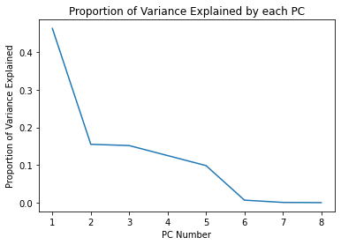
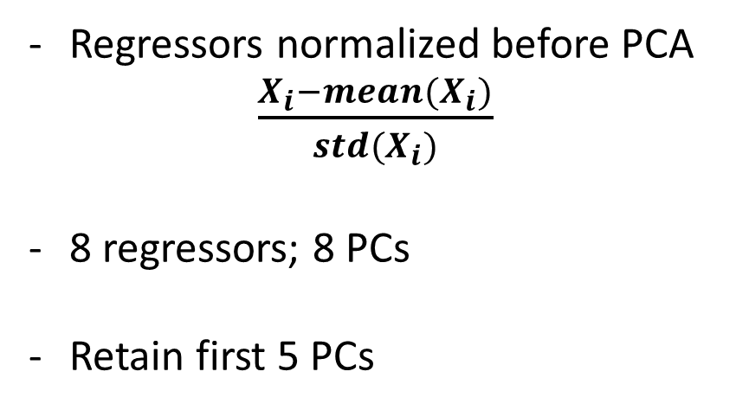
PCA
Regressors normalized before PCA
$\frac{X_{i}−mean(X_{i})}{{std(X}_{i})}$
8 regressors; 8 PCs
Retain first 5 PCs
Notes:
Orient to plot first

Slide 12
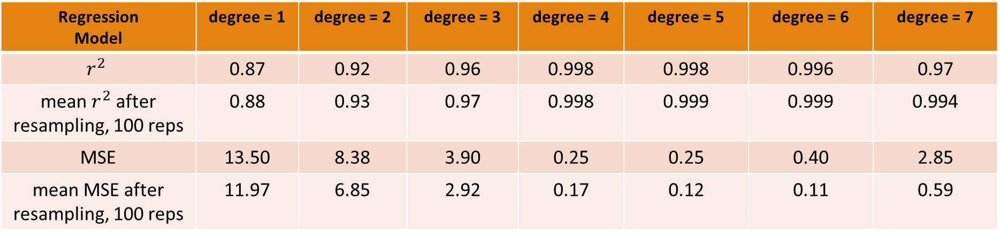
Heating load ~ PC1+PC2+PC3+PC4+PC5
80/20 Train test split
Regression Model | degree = 1 | degree = 2 | degree = 3 | degree = 4 | degree = 5 | degree = 6 | degree = 7
$$r^{2}$$ | 0.87 | 0.92 | 0.96 | 0.998 | 0.998 | 0.996 | 0.97
mean $r^{2}$ after resampling, 100 reps | 0.88 | 0.93 | 0.97 | 0.998 | 0.999 | 0.999 | 0.994
MSE | 13.50 | 8.38 | 3.90 | 0.25 | 0.25 | 0.40 | 2.85
mean MSE after resampling, 100 reps | 11.97 | 6.85 | 2.92 | 0.17 | 0.12 | 0.11 | 0.59
Notes:
Orient to plot first

Slide 13
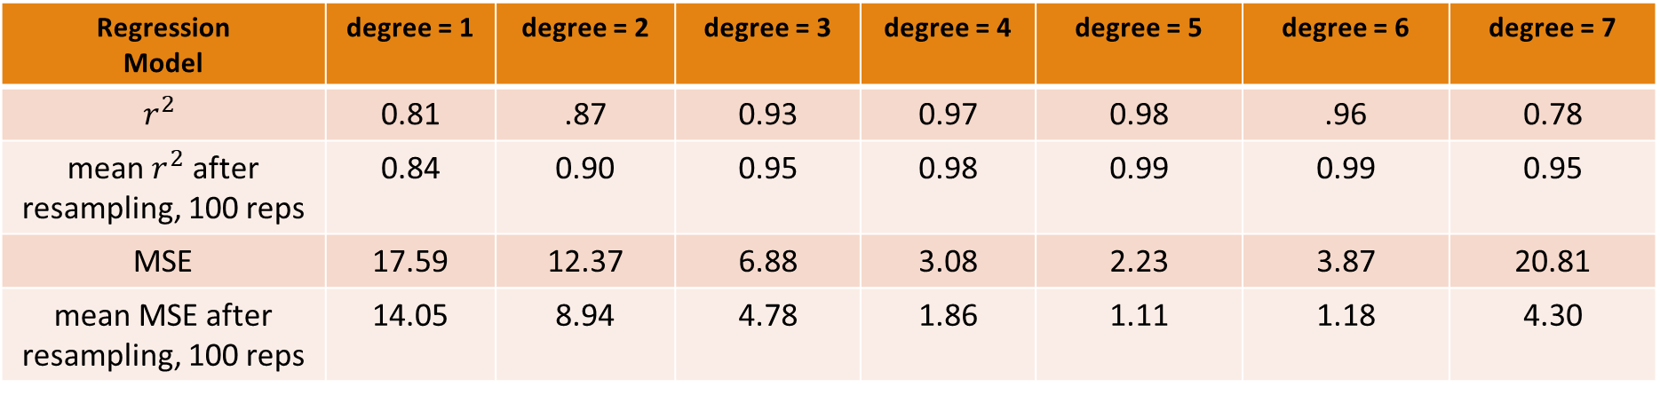
Cooling load ~ PC1+PC2+PC3+PC4+PC5
80/20 Train test split
Regression Model | degree = 1 | degree = 2 | degree = 3 | degree = 4 | degree = 5 | degree = 6 | degree = 7
$$r^{2}$$ | 0.81 | .87 | 0.93 | 0.97 | 0.98 | .96 | 0.78
mean $r^{2}$ after resampling, 100 reps | 0.84 | 0.90 | 0.95 | 0.98 | 0.99 | 0.99 | 0.95
MSE | 17.59 | 12.37 | 6.88 | 3.08 | 2.23 | 3.87 | 20.81
mean MSE after resampling, 100 reps | 14.05 | 8.94 | 4.78 | 1.86 | 1.11 | 1.18 | 4.30
Notes:
Orient to plot first

Slide 14
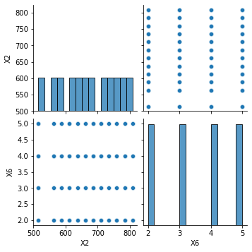

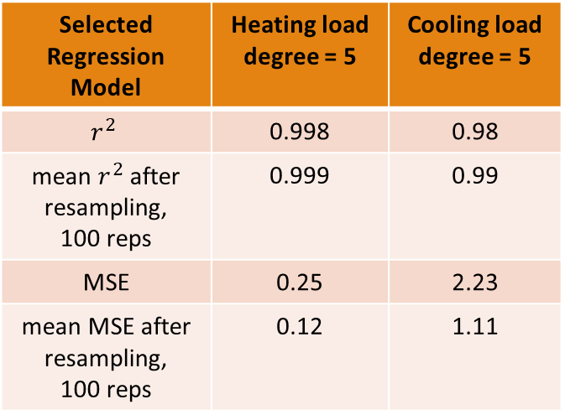
Why a higher $r^{2}$/lower MSE after resampling?
X2 Values (Surface Area) | X2 Value Counts
514.5 | 64
563.5 | 64
588.0 | 64
612.5 | 64
637.0 | 64
661.5 | 64
686.0 | 64
710.5 | 64
735.0 | 64
759.5 | 64
784.0 | 64
808.5 | 64
Selected Regression Model | Heating load degree = 5 | Cooling load degree = 5
$$r^{2}$$ | 0.998 | 0.98
mean $r^{2}$ after resampling, 100 reps | 0.999 | 0.99
MSE | 0.25 | 2.23
mean MSE after resampling, 100 reps | 0.12 | 1.11
Notes:
Orient to plot first

Slide 15
Thank you!
Questions?
Notes:
Orient to plot first

